Slide 1
Speaker process
Use this template and PowerPoint 2016 when formatting your session deck
Final decks are due on Friday, February 8 and must be uploaded by 6:00pm PT
Login to your speaker portal at https://www.microsoftready.com
In the “My Sessions” section, click the "Manage Slides” link for each session listed
Slide Deck Management tool opens; follow the steps on that page to upload your PPT deck
You will also find the deck ready for your session on the PPT computer in your session room
After Friday, February 8 at 6:00pm PT, PPT decks must be brought onsite to Silver Fox (the Presentations Group) located in Speaker Workrooms at the WSCC, TCC, Sheraton, and Hyatt.
Additional details and resources are available on your speaker portal at https://www.microsoftready.com

Slide 2
Hotel WiFi Info
SSD ID: MSFTWIFI
Pass: Microsoft

Slide 4
Mastering Azure networking concepts
AI-CI-TS336
Jon Ormond, Principal PM
Azure Networking

Slide 5
Session learning objectives
Business Problems:
Contoso has a data center on the West coast (Seattle, USA) and their main office in East US (Ashburn, Virginia) they need a WAN for cross-”on-premises” network communication
Contoso is building a bi-coastal web presence and needs to geo-load balance their East US and West US Azure sites with connections back to their on-premises data center.
At the end of this session, you should be better able to…
discuss ExpressRoute Global Reach, when to use and why
discuss Azure Front Door, when to use and why
be hands on with Global Reach and Front Door
discuss the new Azure Az PowerShell Module
Pre-day: articulate high-level PowerShell deployment concepts
Pre-day: build Global Reach and Front Door deployments
Notes:
Audience questions:
Who is here for Global Reach? (can anyone tell me what Global Reach is?)
Who is here for Front Door? (can anyone tell me what Front Door is?)
Who is here for both? You’re my people! ☺
Anything we should put in the parking lot to cover if time allows?

Slide 6
Azure PowerShell SDK Update

Slide 7
New Azure PowerShell SDK - Az
New Azure PowerShell SDK Module - Az
Not compatible with AzureRM (ie can’t be installed side by side)
There is an alias set, so AzureRM commands will still work
It’s not required now, but new features are going into Az only
New Azure Login Method
Connect-AzAccount
Do this in an admin PowerShell console session to give permanent access for a machine
AzureRM commands should work with Enable-AzureRmAlias
https://azure.microsoft.com/blog/how-to-migrate-from-azurerm-to-az-in-azure-powershell/

Slide 8
Idempotent PowerShell Operations
# 3.3 Create Public IPs
Write-Host (Get-Date)' - ' -NoNewline
Write-Host “Creating Public IP address“ -ForegroundColor Cyan
Try {$pip = Get-AzPublicIpAddress -ResourceGroupName $ResourceGroup `
-Name $VMNameASH'-pip' -ErrorAction Stop
Write-Host "resource exists, skipping“
}
Catch {$pip = New-AzPublicIpAddress -ResourceGroupName $ResourceGroup `
-Location $EastRegion `
-AllocationMethod Dynamic `
-Name $VMNameASH'-pip’
}

Slide 9
Building the Environment

Slide 10
Final Environment

Slide 11
Starting Point (30 minutes)
Execution:
Connect to WiFi
Browse to https://portal.azure.com
Get user name and password in KeyVault
Using those creds, RDP to Ops Desktop
RDP: ash.pathlab.xyz:200xx
On Ops Desktop, open PowerShell run Connect-AzAccount
Login using @microsoft.com
Run Get-AzResourceGroup –Name “CompanyXX” to validate

Slide 12
Starting Point
Execution:
Connect to WiFi
Browse to https://portal.azure.com
Get user name and password in KeyVault
Using those creds, RDP to Ops Desktop
RDP: ash.pathlab.xyz:200xx
On Ops Desktop, open PowerShell run Connect-AzAccount
Login using @microsoft.com
Validation:
Using login from your Key Vault RDP to Ops Desktop in Virginia
On Ops Desktop, use PowerShell to pull resource group from Azure, Run
Get-AzResourceGroup –Name “CompanyXX”

Slide 13
Step 1 (15 minutes)
Execution:
Open WorkshopStep1.ps1 in PowerShell ISE
(at C:\vdcWorkshop\Scripts)
Run WorkshopStep1.ps1

Slide 14
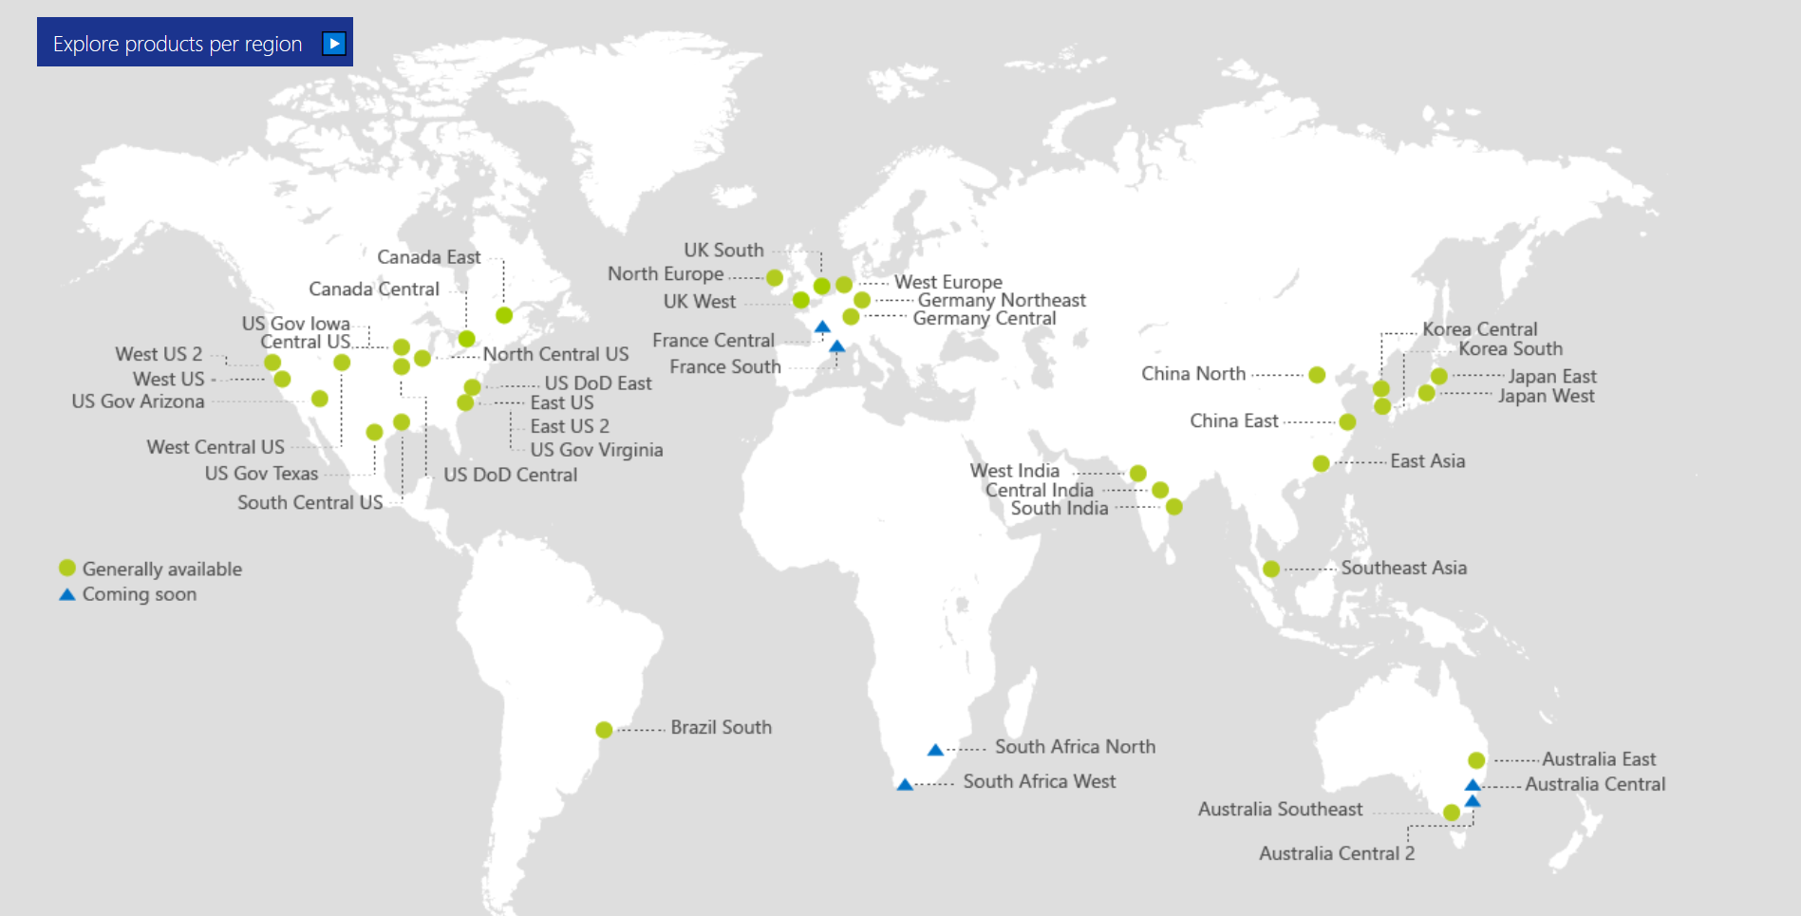
Also Announced:
Germany North
Germany West Central
Switzerland North
Switzerland West
Norway East
Norway West
UAE Central
UAE North

Slide 15
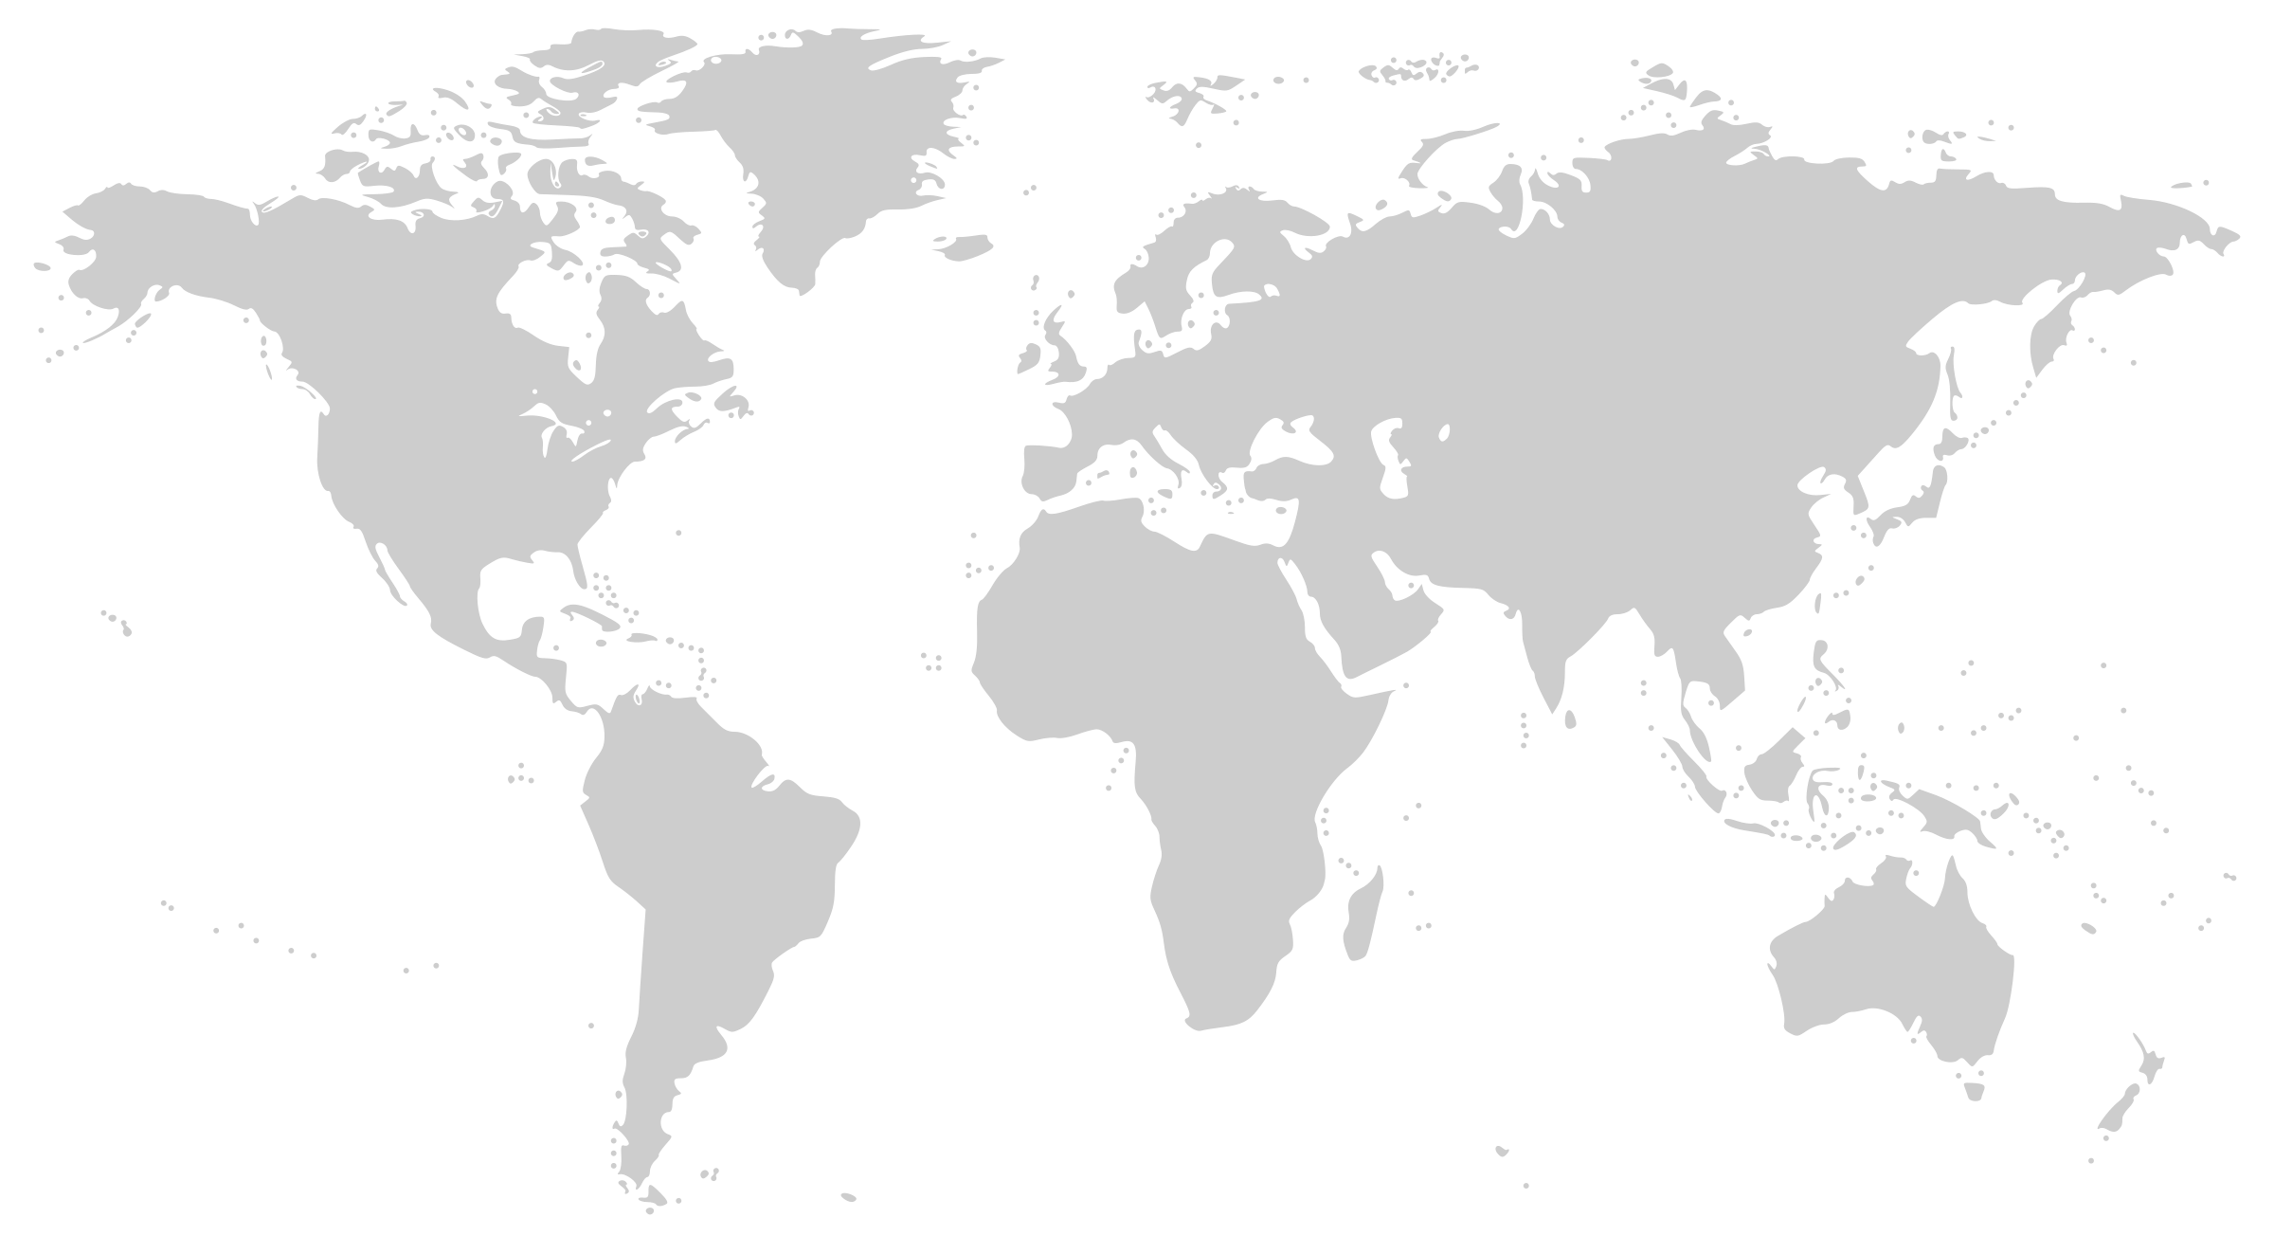
Microsoft Global Network
Greenland
Svalbard
United States
Sweden
Norway
Russia
Canada
United Kingdom
Poland
Ukraine
Kazakistan
Russia
One of the largest private
networks in the world
100K+ miles of lit fiber
130+ edge sites
8,000+ ISP sessions
44 ExpressRoute locations
200+ ExpressRoute Partners
SDN Managed (SWAN, OLS)
France
United States
Turkey
Algeria
Iran
China
Pacific Ocean
Mexico
Atlanta Ocean
Libya
Egypt
Saudi Arabia
India
Myanmar (Burma)
Mali
Niger
Chad
Sudan
Pacific Ocean
Nigeria
Ethiopia
Venezuela
Colombia
Dr Congo
Peru
Angola
Indonesia
Brazil
Zambia
Indian Ocean
Bolivia
Nambia
South Africa
Australia
Owned Capacity
Data center
Argentina
Leased Capacity
Moving to Owned
Edge Site
DCs and Network sites not exhaustive

Slide 16


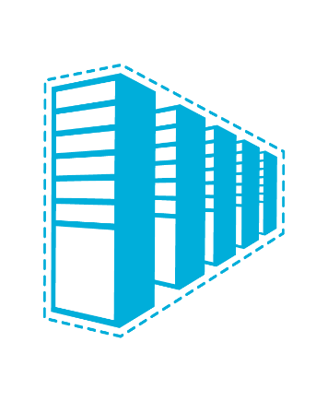


Connectivity options and hybrid offerings
Azure
Customer
Segment and workloads
Consumers
Access over public IP
DNS resolution
Connect from anywhere
Internet connectivity
Developers
POC Efforts
Small scale deployments
Connect from anywhere
Secure point-to-site VPN connectivity
SMB & Enterprises
Connect to Azure compute
Connect branch to branch
Virtual WAN and Site-to-site
VPN connectivity
SMB & Enterprises
Mission critical workloads
Backup/DR, media, HPC
Connect to all Azure services
ExpressRoute private connectivity

Slide 17







Azure ExpressRoute
Private connectivity to Microsoft
Predictable performance
Enterprise-grade resiliency and with SLA for availability
Large and growing ExpressRoute partner ecosystem
Customer’s Network
Partner Edge
Primary Connection
Microsoft Edge
Secondary Connection
ExpressRoute Circuit
Microsoft Peering for Dynamics 365, Azure public services (public IPs)
Azure Private Peering for Virtual Networks

Slide 18

Azure ExpressRoute Direct
Announcing
Preview
10X
Breaking the speed barrier
Fastest of all cloud providers!
ExpressRoute Direct
100 Gbps direct to Azure
Built for customers with extreme bandwidth needs for massive data ingestion
Flexibility in bandwidth allocation
In-geo and global connectivity
ExpressRoute Peering Location

Slide 19
Step 1
Execution:
Open WorkshopStep1.ps1 in PowerShell ISE
(at C:\vdcWorkshop\Scripts)
Run WorkshopStep1.ps1
Validation:
Browse to Azure Portal
Review both ER circuits
Wait for Provider Status to change to “Provisioned” before continuing

Slide 20
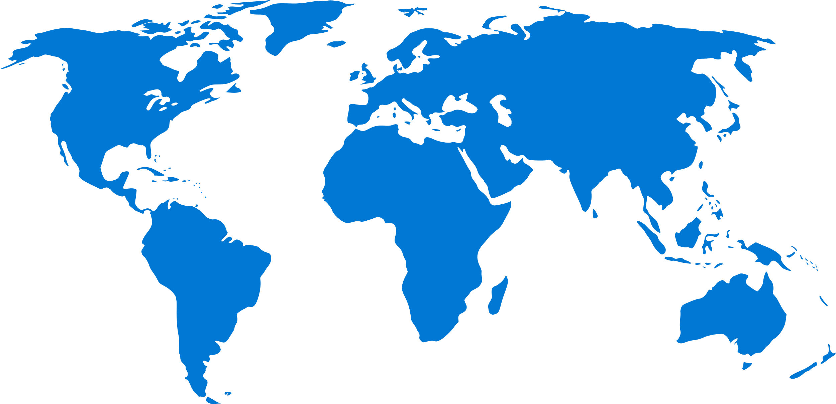

ExpressRoute Global Reach
Preview
Deploy global site-to-site connectivity using the Microsoft global network
On-demand connectivity between your sites using existing ExpressRoute circuits
Complements your service provider’s WAN solution
Traffic stays on Microsoft’s global network
Available in Public Cloud
U.S., U.K., Hong Kong, Ireland, Netherlands, Japan
Australia, Singapore and Korea coming soon
Available in US Government Cloud

Slide 21
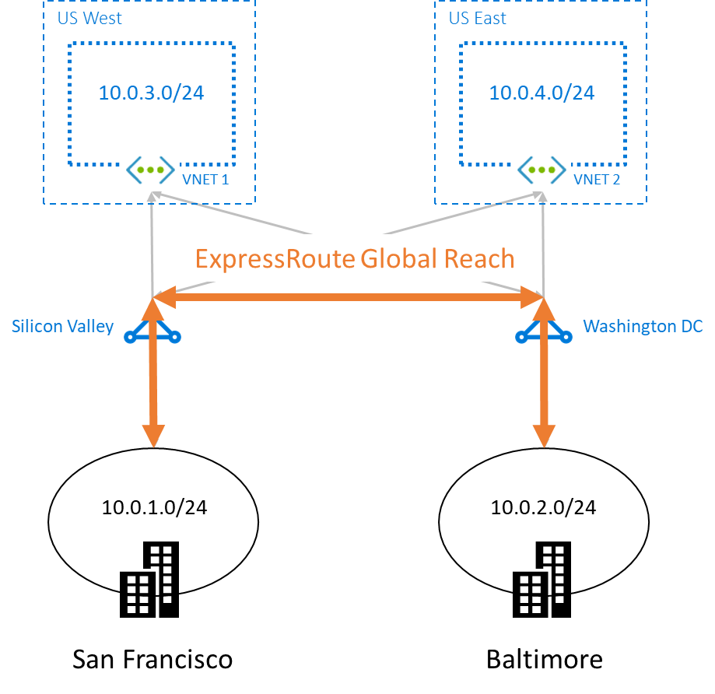
ExpressRoute – Global Reach
Preview

Slide 22
Step 2 (15 minutes)
Execution:
Open WorkshopStep2.ps1 in PowerShell ISE
Run WorkshopStep2.ps1

Slide 23
Step 2
Execution:
Open WorkshopStep2.ps1 in PowerShell ISE
Run WorkshopStep2.ps1
Validation:
From the Ops Desktop, ping File Server in Seattle
From the Ops Desktop, use file explorer to view remote file at \\10.3.xx.10\WebShare

Slide 24
Step 3 (50 minutes)
Execution:
Open WorkshopStep3.ps1 in PowerShell ISE
Run WorkshopStep3.ps1

Slide 25
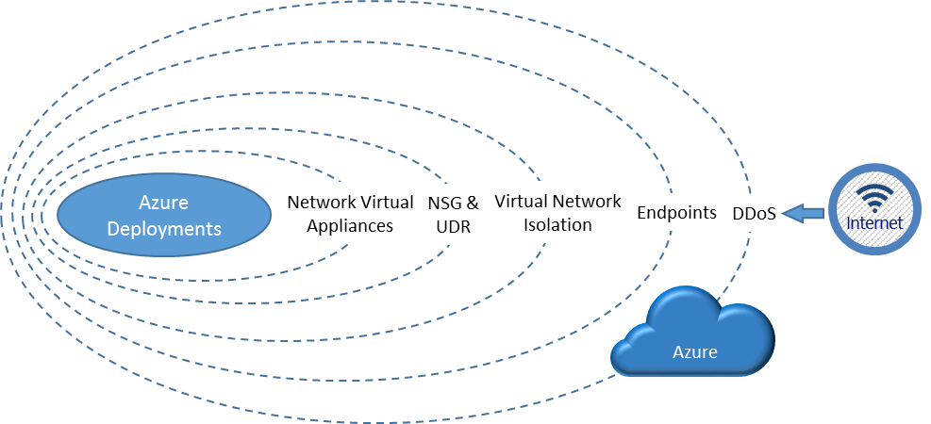
Visualizing layers of security

Slide 26
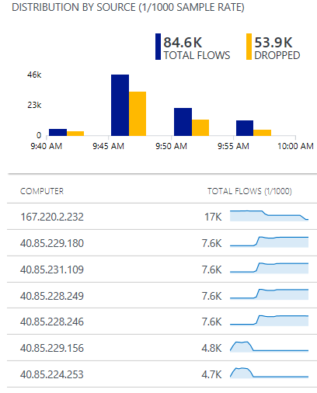
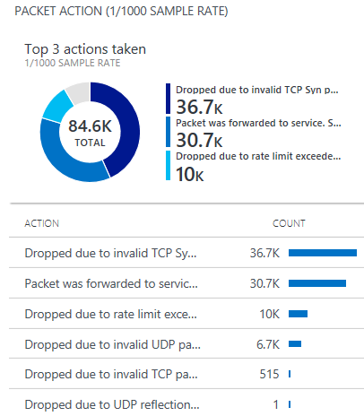
Azure DDoS Protection
GA
Cloud scale DDoS protection tuned to applications
Simple to provision for all your virtual network resources
Always on monitoring with near real time telemetry and alerting
Automatic network layer attack mitigation
Protection policies tuned to your application’s traffic profile
What’s new
DDoS Attack Analytics
Near real time network attack mitigation flow logs
Attack data snapshots and full post attack summary
DDoS Rapid Response
Specialized Rapid Response team support during active attacks
Custom mitigation policy configuration
Azure Security Center integration
Intelligent DDoS Protection virtual network recommendation
Attack flow logs Azure Log Analytics view

Slide 27

Azure Web Application Firewall Protect web sites from common application vulnerabilities
Platform managed WAF
Built in high availability and scalability
Protect application
SQL Injection, XSS, protocol violation & others
Near real time monitoring
Azure Monitor & Azure Security Center
WAF managed rules
OWASP Core Rule Set 3.0 and 2.2.9 native support
Site 1
×
XSS attack
Valid request
WAF
Valid request
Site 2
×
Valid request
New preview features
WAF Configurability
Control request body evaluation
Control request and file sizes
WAF Exclusion List
Exclude request attributes from WAF evaluation
Apply to request header/cookies/parameters
SQL Injection
L7 LB
Application Gateway & WAF

Slide 28
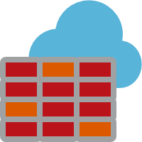
Azure Firewall
GA
Cloud native stateful Firewall as a service
A first among public cloud providers
L3-L7 Connectivity Policies
Spoke 1
NAT, Network and Application traffic filtering rules allows Inbound/Outbound access
Central governance of all traffic flows
Built-in high availability and auto scale
Network and application traffic filtering
Centralized policy across VNets and subscriptions
Complete VNET protection
Filter Outbound, Inbound, Spoke-Spoke & Hybrid Connections traffic (VPN and ExpressRoute)
Centralized logging
Archive logs to a storage account, stream events to your Event Hub, or send them to Log Analytics or Security Integration and Event Management (SIEM) system of choice
Central VNet
Spoke2
Azure Firewall
Spoke VNets
Azure to On-Prem traffic filtering
Traffic is denied by default
On-Premises
Notes:
Easily configure connectivity policies for all your resources using network & application (fully qualified domain name filtering) rules
Both inbound and outbound support and NAT (SNAT and DNAT)
FQDN Tags support (e.g. Windows Update, ASE) to allow easy rule creation
Deployed in a click; fully integrated with the Azure Platform

Slide 29
Step 3
Execution:
Open WorkshopStep3.ps1 in PowerShell ISE
Run WorkshopStep3.ps1
Validation:
Hit East IIS public IP with laptop browser
Hit West IIS public IP with laptop browser

Slide 30




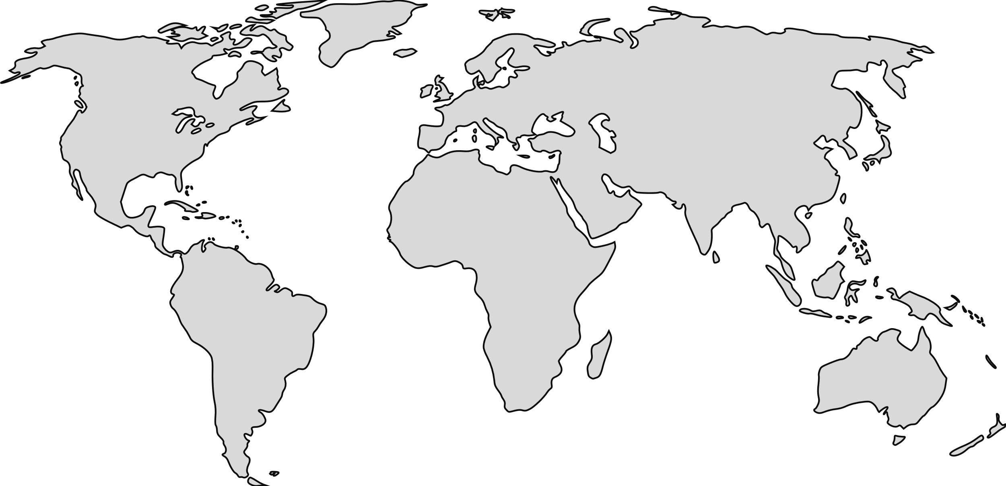





Load balancing in Azure
Preview
Application Gateway
Application Gateway
Front Door
Traffic Manager
Load Balancer
(Public)
Load Balancer (Internal)
Global
Region / Zone
Global
Regional
Internal
Route to your closest available service region or your on-prem DC. Offload SSL, improve performance / accelerate websites at the Edge.
Route across zones and into your VNET. Offload SSL and build your application-specific logic.
Route across and between your resources to build your regional application.

Slide 31





Building for global scale
Web applications
Streaming, Gaming & Cross premises
Maximize global reliability and performance with cross-region and zonal redundancy.
Maximize availability of non http workloads globally OR migrate to the cloud across regional and on-prem resources for all protocols
Global
Preview
Front Door
Global
Traffic Manager
+
Regional
+
Application Gateway
Regional
& Internal
On Prem
+
Application
Front End
Load Balancer
Internal
Web Apps
API Apps
Functions
Mobile Apps
Logic Apps
Internal
Load Balancer
Application
Back End
Services

Slide 32

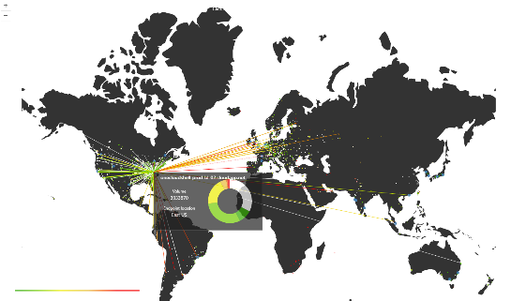



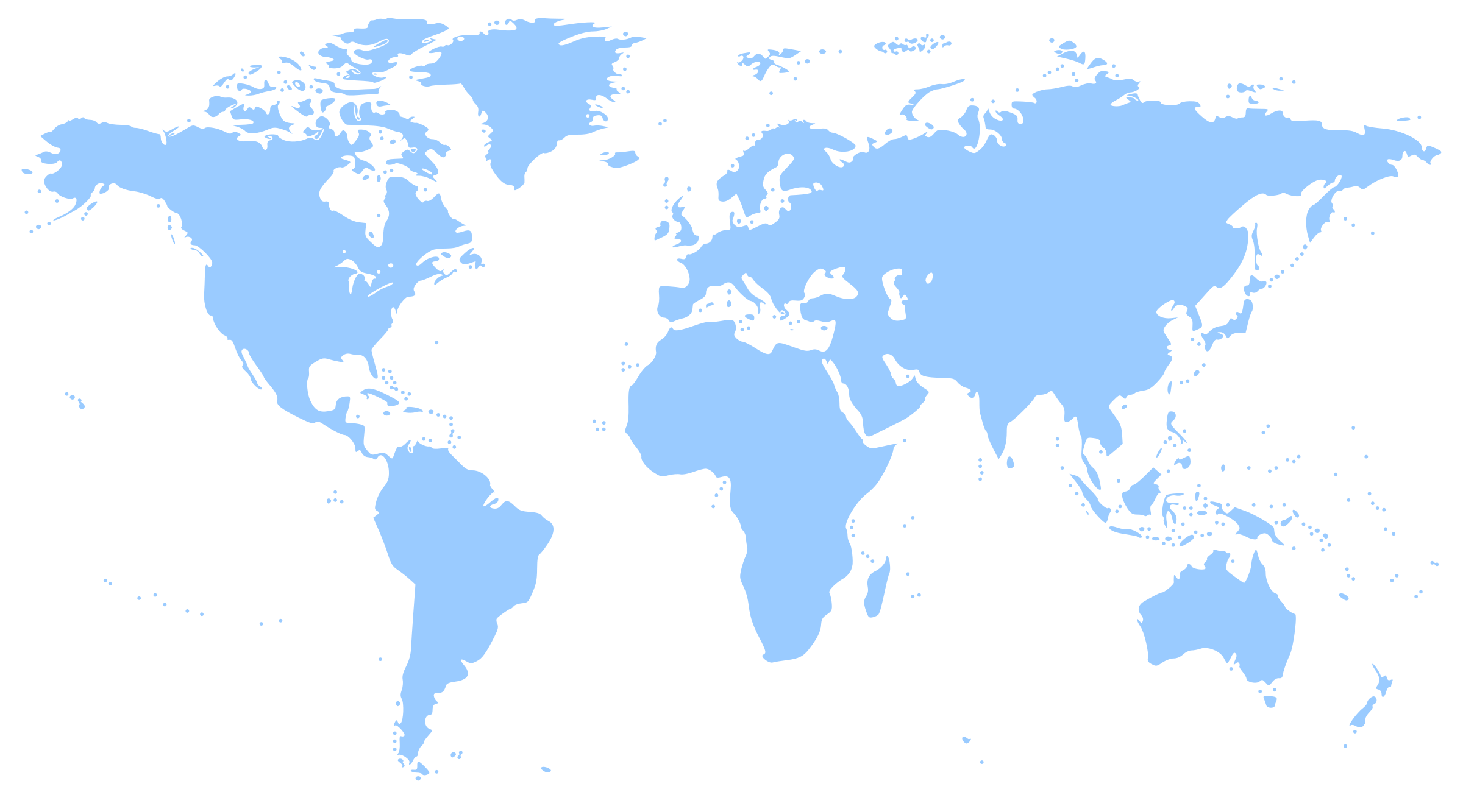



Azure Traffic Manager
Smart Traffic Engineering for Azure and external endpoints
Intelligent Routing
Geo, Subnet, Failover, Latency & Weighted
Traffic View
Actionable Insights
on real time data
Analytics and Logs
Identify patterns &
detect threats
What’s new
Add your endpoints using IPv4 / IPv6 addresses
Multi-value responses for increased availability
Route traffic to multi-tenant endpoints using custom headers
Specify custom HTTP response codes to indicate endpoint health
Subnet routing: Deliver customized content for ISPs or corporate offices

Slide 33


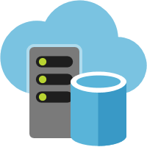
Azure Front Door Service
Preview
Your global entry-point to the cloud
Application acceleration
HTTP proxy at the edge of Microsoft’s global network
Reduce latency and improve throughput for your app
Scale out with massive SSL offload
Supports IPv6
Global HTTP/S load balancing
Active probing with global instant failover
Path based routing for microservices
Request rate limiting
Sticky, weighted and priority routing
Global insights
Central traffic dashboard
Regional backend health

Slide 34
Step 4 (25 minutes)
Execution:
Open WorkshopStep4.ps1 in PowerShell ISE
Run WorkshopStep4.ps1

Slide 35


Application Gateway
Layer 7 load balancer for web applications
Platform managed built in high availability and scalability
Layer 7 load balancing URL path, host based, round robin, session affinity, redirection
Centralized SSL management SSL offload and SSL policy
Public or ILB public internal or hybrid
Rich diagnostics Azure monitor, Log analytics
What’s New
Features
Connection draining support
Custom error pages
Ingress Controller for Azure Kubernetes Service (AKS) preview
Diagnostics
Enhanced multi dimensional metrics
Diagnose connectivity issues with Network Watcher integration
Portal enhancements
Complete API Parity
SSL policy, VMSS, Web App Services, Custom error pages, Redirection, Connection draining
And more features …
Web App Service
Site 1
Internet
Application Gateway
Site 2
VPN
On-Premises

Slide 36
Application Gateway continued what’s new
Preview
Performance and scalability
Autoscaling
Grows and shrinks based on application traffic requirements
Reduce operating cost
Better performance 5X better SSL offloads
550 connections/sec with RSA 2048 bit key Certs
30,000 persistent connections
2500 HTTP req/sec
Faster provisioning and configuration update
75% reduction in provisioning time (~5 mins)
85% reduction in config updates time (~40 secs)
Enhanced resiliency
Built in Azure zone redundancy
Choose single zone or multi zone Application Gateway
Feature enhancements
Robust Application Gateway IP static VIP
More features upcoming (Key Vault integration, modify headers)
Static VIP
Min capacity
Scale out at load
AZ1
AZ2
VMSS
VMSS

Slide 37


Azure Load Balancer
Inbound
Outbound
Cloud native network load balancer
Built-in high-availability and performance
Inbound and Outbound
Public and Internal load balancing
Availability Zones
Flexible for all TCP or UDP applications
Any VM in a VNet
HA Ports for n-active resiliency
Health probe for TCP, HTTP, and HTTPS
Metrics in Azure Monitor
Multi-dimensional
3rd party integration
Health
Probe
AZ1
AZ2
VMSS
VMSS
VNet
Pool
SNAT ports
per VM
VNet
HA Ports for Appliances
VNet

Slide 38
Step 4
Execution:
Open WorkshopStep4.ps1 in PowerShell ISE
Run WorkshopStep4.ps1
Validation:
Browse to https://CompanyXX-fd.azurefd.net from Ops Desktop (should get East IIS)
Browse to https://CompanyXX-fd.azurefd.net from laptop (should get West IIS)

Slide 39
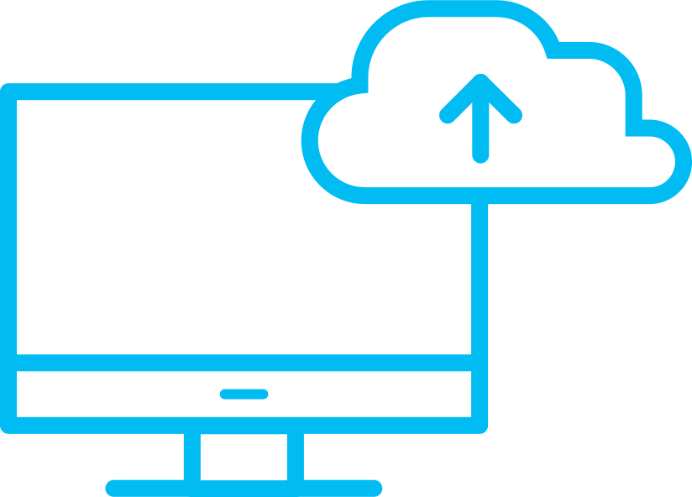
Azure DNS
Host DNS Zones with High Availability
100% Availability SLA
Reliability via Global anycast network
Our redundant data plane gives 100% reliability for your DNS zones.
Multiple nodes around the world advertise a given IP address providing reliable responses even in event of a node failure.
Announcing DNS Alias records
Keep your DNS records automatically updated when IPs change for your ARM resources.
Dynamic, instantaneous updates to your DNS zone ensures zero downtime for your applications.
Run a load balanced application directly at your Zone Apex by Alias to Traffic Manager, or any Public IP fronted service such as Application Gateway.

Slide 40

Azure Virtual WAN
GA
Easy deployment of large-scale branch connectivity
VNet
Branch to Azure, Branch to Branch
Automated provisioning and configuration
Scalability and high throughput
Large and growing integrated partner ecosystem
VNet
VNet
VNet
VPN
VPN
VPN
Internet
Region 1
Region 2
Region 3
Branch
Branch
Branch
Branch
Notes:
Mention traffic flow

Slide 41





Azure Virtual WAN – Unified Cloud Connectivity
GA
Features
VNet
Hubs in Azure
Enable/disable branch to branch
IPsec IKEv1 and IKEv2
Scale unit-based billing
E2E Monitoring and Resource Health
ExpressRoute (Preview)
P2S with IKEv2 and OpenVPN (Preview)
O365 Policy (Preview)
VNet
Corp HQ
VNet
ExpressRoute
VNet
Datacenter
ExpressRoute
VPN
VPN
VPN
Internet
Region 1
Region 2
Region 3
Internet
Branch
Branch
Branch
Branch
Notes:
Branch office connect using Ipsec – see limits of 2 to 4 Gbps
For larger offices and DC you may need higher throughput OR locations that don’t have good Internet ExpressRoute is a good option.

Slide 42

















Network Monitoring
Rich set of tools to monitor all areas of applications and infrastructure
Fully integrated into Azure Monitor
Visualize
Monitor & Troubleshoot
Respond and Integrate
Dashboards
Network Topology
Connection Monitor
ER Monitor
VPN Troubleshoot
NSG Flow logs
Alerts
Autoscale
Functions
Analyze
Azure Monitor
Resource Health
Activity logs
Connection Troubleshoot
Packet Capture
Event Hubs
Logic Apps
3rd Party
Metrics Explorer
Traffic Analytics
Network Watcher
Notes:
Need context

Slide 43
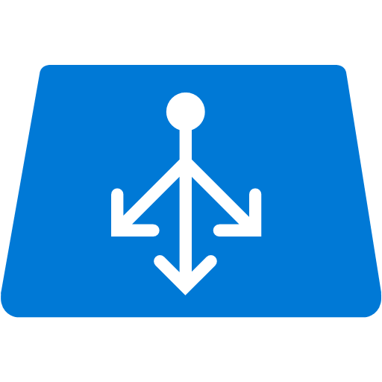


Virtual Network TAP
Preview
Continuous streaming of virtual machine network traffic to packet collector
First native distributed cloud scale TAP available in public cloud!
Continuous streaming of virtual machine network traffic to packet collector
Agentless!
Enabling network and application performance management solutions, security analytics tools​
Complete segmentation ​of security ops and VM owner in a monitoring boundary
Azure Load Balancer
Tools
Network Packet
Broker
Application
Operations
Web Tier Subnet
Network
Operations
Virtual Network TAP
Security
Operations
App Tier Subnet
Monitoring Subnet
Forensics
VM Production Traffic
VM Mirrored Traffic

Slide 44
Session takeaways
ExpressRoute Global Reach lets customers use the Microsoft global backbone network as they see fit, “Our backbone is your backbone”
Global Reach allows on-prem to on-prem communication using Microsoft’s network
Azure Front Door is the best application acceleration technology on the internet because we control the back-end network, it’s not the internet!
Azure Front Door for fast geo-load balancing and acceleration, Application Gateway for Application Delivery Controller (ADC) in region
Notes:
This slide is required. Do NOT delete. This slide is required just prior to the “session resources” slide
SESSION TAKEAWAYS & ACTIONS: Bullet points highlighting the primary actions learners should take away or knowledge learners should recall to help them successfully perform in role (e.g. practical guidance, tips, suggested behavior changes.)
Please Note: Session Takeaways are not required for Group Discussions; however, takeaways should be captured real time by the facilitator during the session and those key points should be emphasized during the discussion or workshop. If you have questions, please contact your Track Content Lead.

Slide 45
Session resources
Workshop files and documentation on GitHub: https://aka.ms/vdcWorkshop (AFDLab folder)
ExpressRoute: https://docs.microsoft.com/azure/expressroute/expressroute-introduction
Global Reach: https://docs.microsoft.com/azure/expressroute/expressroute-global-reach
Azure Front Door: https://docs.microsoft.com/azure/frontdoor/front-door-overview
Virtual WAN: https://docs.microsoft.com/azure/virtual-wan/virtual-wan-about
Azure Firewall: https://docs.microsoft.com/azure/firewall/overview
Azure DNS: https://docs.microsoft.com/azure/dns/dns-overview
Az Module Blog: https://azure.microsoft.com/blog/how-to-migrate-from-azurerm-to-az-in-azure-powershell/
Microsoft Ready content can be found at https://digital.microsoftready.com/
Notes:
This slide is required. Do NOT delete. This slide is required at the end of your session to recap additional resources.
Use this slide to share additional available content that attendees can leverage after the event. In this section you can call out whitepapers, websites, communities, etc. that might be useful for the learner.

Slide 46

Evaluations can be submitted via:
Enjoy a session
Fill out an evaluation
Win a prize
Make MS Ready better
Laptop/Mobile
connect to Schedule Builder on www.microsoftready.com
Windows/Windows Phone
MS Ready App (Search “MS Ready” in the Store)
Your mobile device
scan the QR code to reach your evaluations
*If you plan to remain in this room for the next session, please be sure to scan your badge again at the door prior to the session starting

Slide 47
Q&A
If you have questions please proceed to the Q&A MICROPHONE located in your session room.
Notes:
Display this slide during session Q&A and direct attendees to use the Q&A microphone located in the session room:
Digital Ready session recordings cannot capture Q&A unless it is spoken using the microphone
Attendees in the back of the room may not be able to hear a question from someone in the front of the room
SPEAKERS MUST REPEAT THE QUESTIONS IF THE ATTENDEE IS NOT USING THE Q&A MICROPHONE

